Slide 1


Slide 2


University Of Calcutta
Final year Project report of
Hospital Management System
Submitted in partial fulfilment of the requirements for the BSc. Computer Science Honours .
Department Of Computer Science
1
1

Slide 3

ANGSHUMAN BANERJEE
CU ROLL :- 213611-21-0003
CU REG :- 611-1111-0254-21
SAMRAT DUTTA
CU ROLL :- 213611-21-0012
CU REG :- 611-1111-0281-21
AKASH CHAKROBARTY
CU ROLL :- 213611-21-0019
CU REG :- 611-1111-0296-21
DEBOJYOTI ROY
CU ROLL :- 213611-21-0017
CU REG :- 611-1111-0294-21
2

Slide 4


Honourable teachers of Computer Science Department :-
Mr. Unmesh Mondal
Mr. Goutam Das
Mr. Apurba Jyoti Roy
Mrs. Rimpi Saha
3

Slide 5


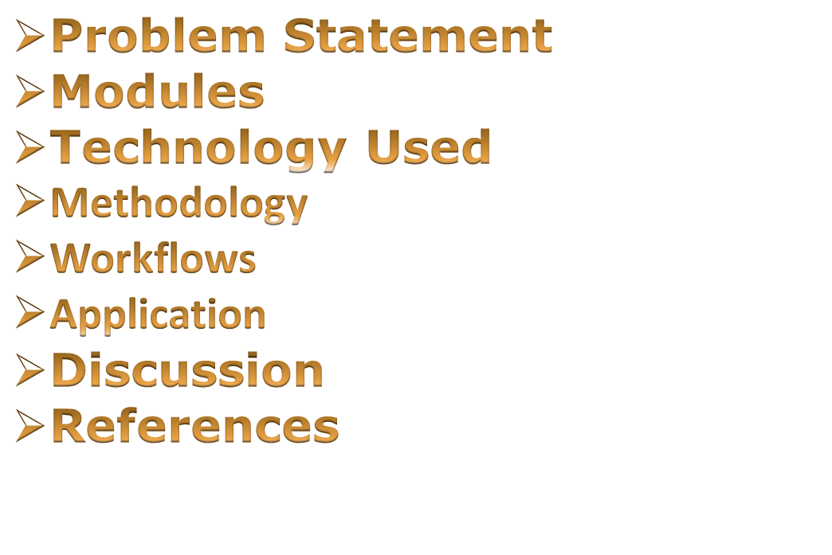
4

Slide 6


Our website addresses the challenges of finding preferable jobs and provide suitable guidance for their dream jobs. Our website also prepares users for the jobs according to their selection.
5

Slide 7

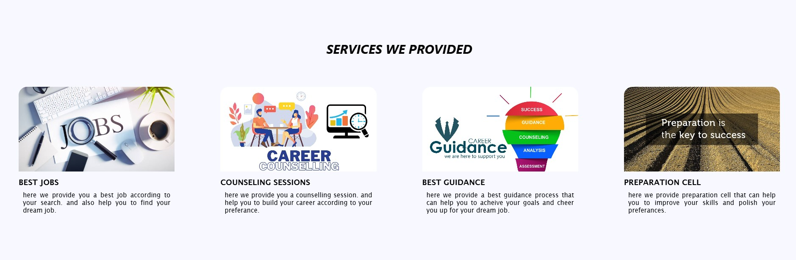
It is having mainly four modules. Names are
JOB SEARCHING MODULE
COUNSELLING MODULE
GUIDANCE MODULE
PREPARATION MODULE
6

Slide 8

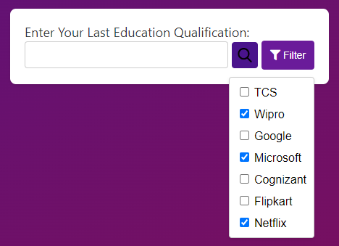
In the Job Search Module, we have tried to give a searching facility to all users according to their present qualification.
7

Slide 9

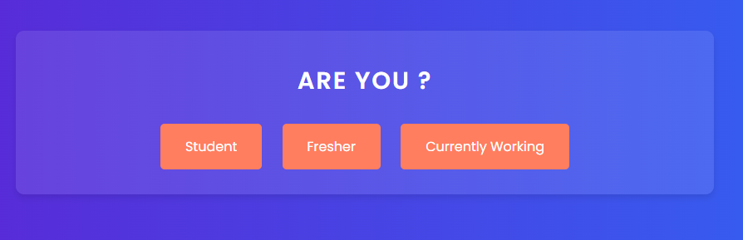
In the counselling module, we have tried to give a counselling procedure to all users according to their requirements.
8

Slide 10

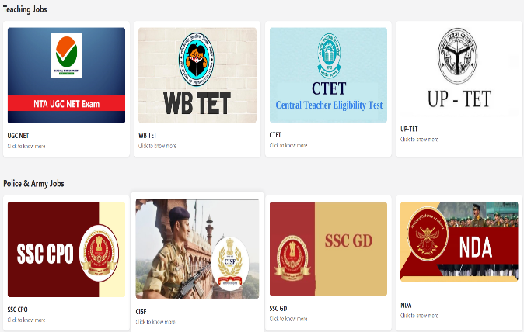
In the Guidance Module, we have tried to produce a proper guidance to all users which will be help all user to choose the correct path or take the correct decision about their future plan.
9

Slide 11

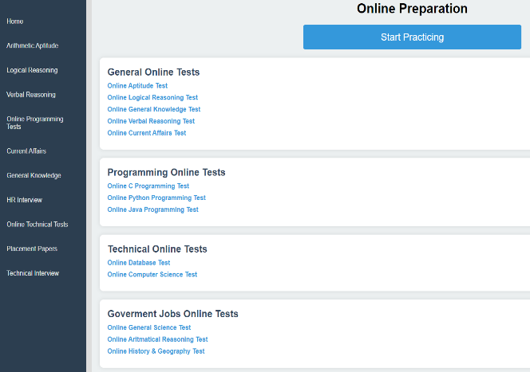
In the Preparation Module, users can prepare themselves by previous year question paper of all individual examination.
10

Slide 12





11

Slide 13

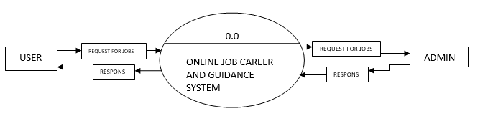
.
12

Slide 14

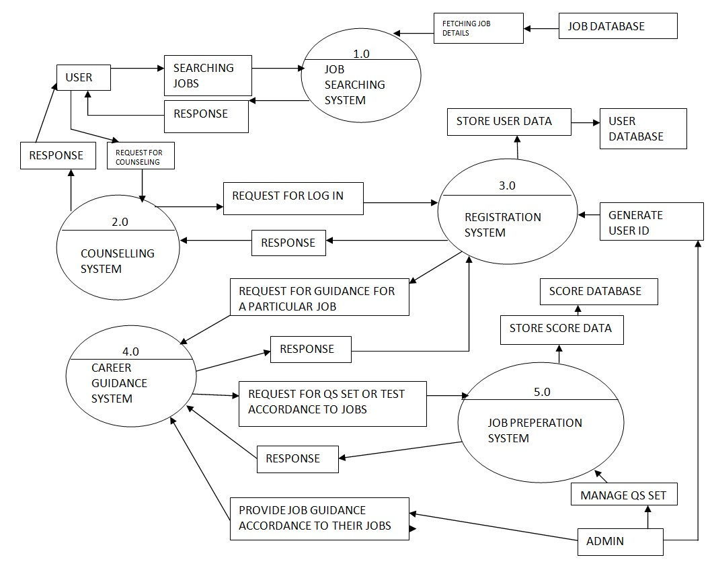
13

Slide 15

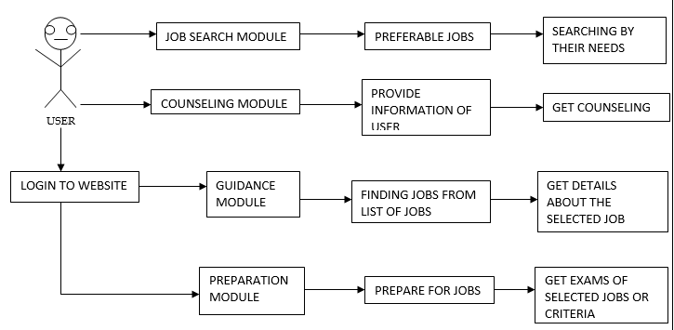
USER WORKFLOW
14

Slide 16
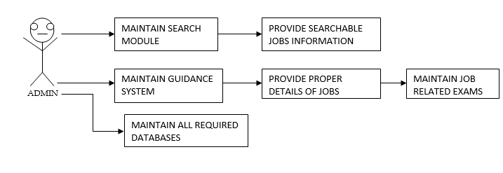
ADMIN WORKFLOW
15

Slide 17


Users can take quizzes and assessments to identify their interests and strengths, helping them understand which career paths may suit them best.
Provide up-to-date information on job market trends, including in-demand skills, industry growth, and regional employment statistics.
It provide us a better solution of our career which we cannot find out by ourself.
Aggregate job listings from various sources, allowing users to search for opportunities based on location, industry, and job title.
9
16

Slide 18


ADVANTAGES :-
Provide up-to-date information on job market trends, including in-demand skills, industry growth, and regional employment statistics that can help user to updated every time.
Aggregate job listings from various sources, allowing users to search for opportunities based on location, industry, and job title.
DISADVANTAGES :-
Users may face technical difficulties such as slow loading times, glitches, or compatibility issues, which can hinder the guidance process.
17

Slide 19

FUTURE SCOPE :-
In the future, we plan to enhance our website by incorporating a one-on-one Q&A conversation feature with industry experts directly on our preparation page. This addition will provide users with personalized insights and advice tailored to their career aspirations, further enriching their preparation experience.
Score Card can be added to Profile Page
Giving users specific guidance page according to their requirements
OTP can be generated when user sign up or sign in through mail.
11
18

Slide 20


Websites:
https://www.w3schools.com/html/
https://www.w3schools.com/css/
https://www.javatpoint.com/javascript-tutorial
https://www.w3schools.com/jquery/default.asp
https://www.w3schools.com/js/
https://www.geeksforgeeks.org/tailwind-css/
https://www.w3schools.com/mysql/default.asp
https://www.w3schools.com/php/
YouTube:
https://www.youtube.com/watch?v=0VxXmuQZUeg
https://www.youtube.com/watch?v=lCxcTsOHrjo
https://www.youtube.com/watch?v=RkduoiH7NNM
11
19

Slide 21


